Slide 1
CTA Compliance Alert – All Associations Must Register Before 2025
(888) 800-1042

Slide 2
Presents
CTA Compliance Alert-
All Associations Must Register Before 2025
Presented By:
Nicholas J. Meinert, Esq.
Scott D. Weiss, Esq., CCAL

Slide 3
CTA Background & Origins
Enacted by Congress on January 1, 2021, as part of the National Defense Authorization Act.
Intended to help prevent and combat money laundering, terrorist financing, corruption, and tax fraud.
FinCen is a Bureau of the United States Department of the Treasury that collects and analyzes information about financial transactions in order to combat domestic and international money laundering and terrorist financing.

Slide 4
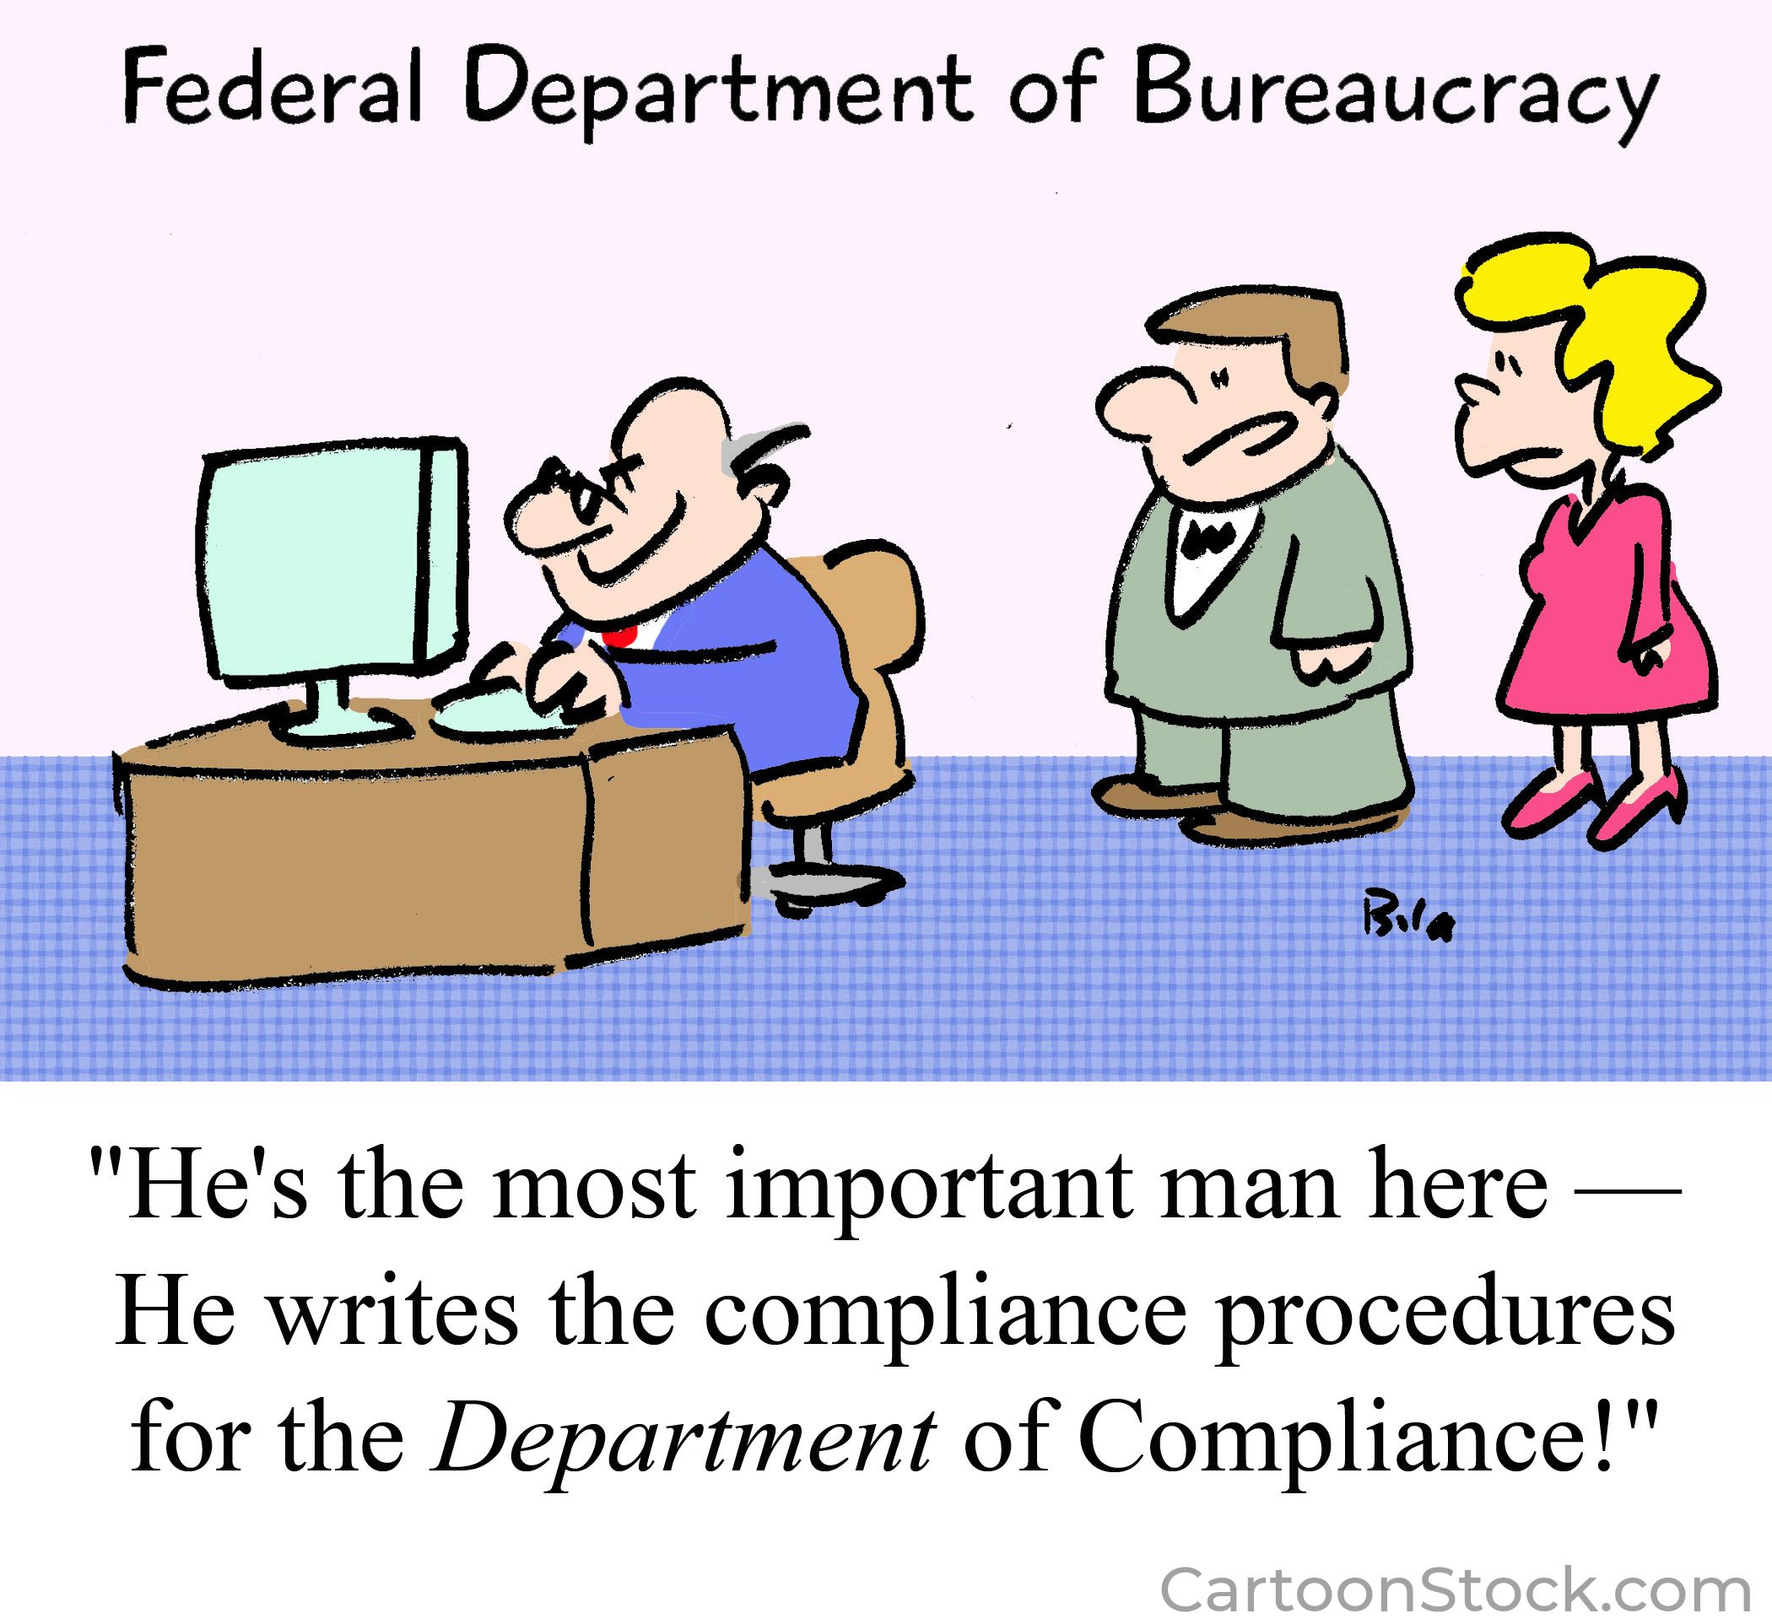
Who Must Comply?
All “Reporting Companies” in the United States with bank accounts.
All companies registered with secretary of state that does not fit exceptions.

Slide 5
Who Must Comply?
There are exceptions, BUT:
Corporations (like associations) do not meet an exception, unless:
You have more than 20 FTEs
Filed a Federal Income tax return with more than
$5 Million in Gross Receipts
3. Operating presence at a physical office in the US

Slide 6
Who Must Comply?
Is the Association a “Reporting Company” pursuant to the CTA?
YES!!!!
Are management companies and business partners?
Likely yes for the company itself, unless it qualifies for an exception
If yes, must report on the Beneficial Owners

Slide 7
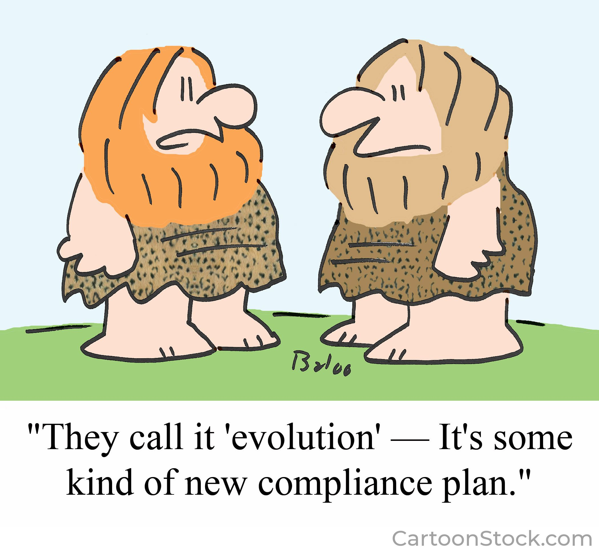
Who Are Beneficial Owners?
Any individual who, directly or indirectly through any contract or relationship…
Exercises substantial control
Owns 25% or more of the entity

Slide 8
Who Are Beneficial Owners?
Substantial control in a community association may mean:
Officers
Directors
Committee members?
Generally, community association managers do not have substantial control, and therefore are not required to report as one of the association’s beneficial owners

Slide 9
Reporting Requirements
Each Beneficial Owner must report:
Full legal name
Date of birth
Current resident or business address
Either an identifying number (passport or driver’s license number) or FinCen identifier
Also must upload a copy of the document verifying the number (passport or driver’s license)

Slide 10
Information Submission
Ways to Submit:
Through FinCen website (website form or upload PDF) – submitter name, email and certification
Third party secured portal

Slide 11
Information Submission
Submission Considerations
Only one submission per association, so need a central person/entity to submit on the association’s behalf
Two sources of submission liability:
Submitting correct and complete information
Holding and storing personal identifiable information (“pii”)

Slide 12
Information Submission
When to Submit
Reporting companies have until the end of 2024 to submit for the first time (recommend doing so during Q3)
Thereafter, reporting companies must submit updated information annually, and within 30 days of any change in beneficial owners (e.g. board changes)

Slide 13
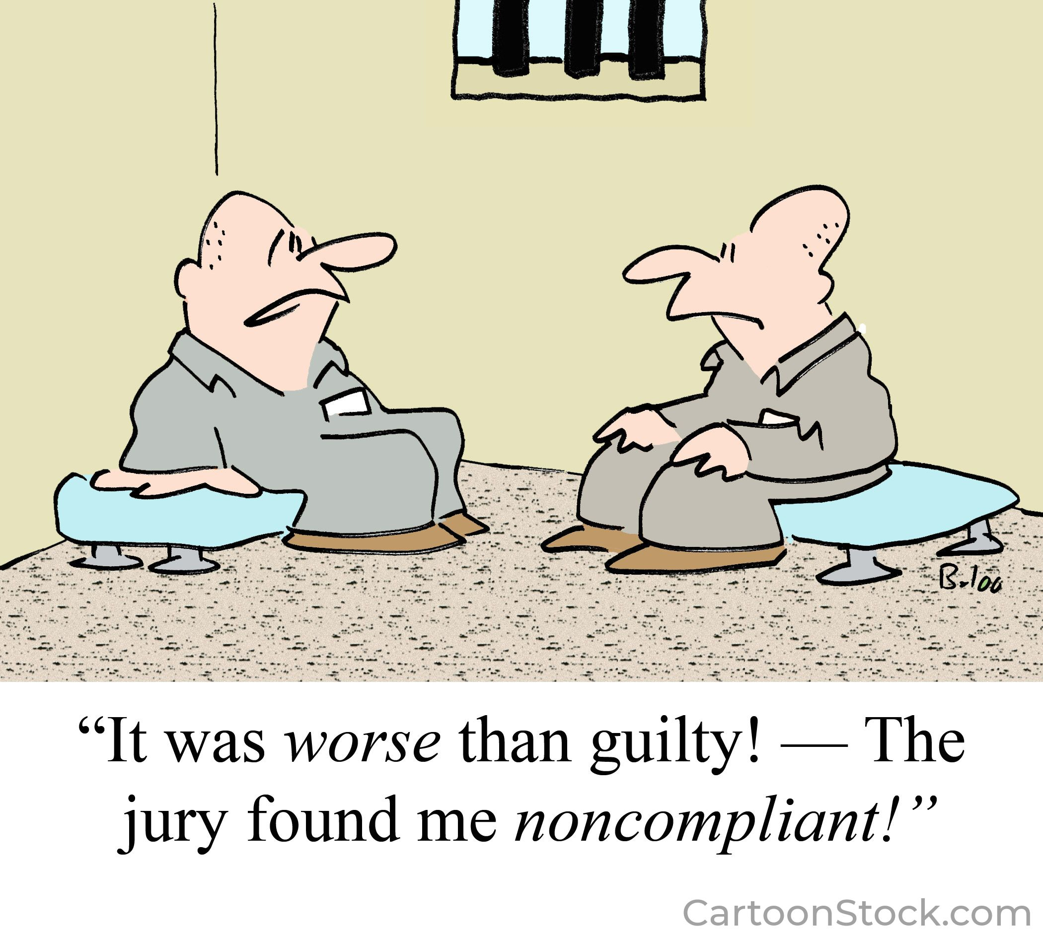
Penalties
Non-Compliance
Not more than $500 for each day that the violation continues. Including updating information.
Up to $10,000, imprisoned for not more than 2 years or both.
Penalties for false information filings and not filing or updating.

Slide 14
Board Compliance Remedies
What if Board Members Refuse to Provide Information?
Board can pass rule requiring directors to provide required information
Remaining directors could levy enforcement assessment against non-complying director
Condominium boards can amend bylaws without an owner vote to require as a qualification to serve on the board

Slide 15
CTA in the Future
CTA Uncertainty
One court in the US has found unconstitutional, but that ruling only applies to that case
Still possible for Congress to delay implementation, but unlikely, so associations need to plan

Slide 16
Thank you!

